Slide 1
Maximizing Incremental Store Visits Under a Limited SMS Budget
Customer Segmentation and Uplift Modeling for SMS Targeting
__________________________________________________
Nuria Castellsague Kharbouch | Data Science Capstone

Slide 2
Dataset:
BIGTARGET hackathon dataset (LENTA + Microsoft).
687,029 rows & 196 columns
Customer behavior, demographic, treatment, and outcome variables.
E.g. receipt counts, spending by product group, discount interaction, visit regularity

Slide 3
If SMS budget is limited, how can customers be targeted to maximize incremental store visits relative to sending no SMS?
* This is a CRM targeting problem, not just a response prediction problem.

Slide 4
The Four Customer Types:
Why does this matter?
Budget Constraints & deterring customers!
Sure Things
Persuadables
Lost Causes
Do-Not-Disturbs
- Low response whether contacted or not
- Respond negatively to SMS.
- Not observed in dataset
- Will visit store, regardless
- Probability of visiting store increases due to SMS

Slide 5
Steps:
Build behavior-based customer segments from transaction history.
Estimate uplift inside each segment by comparing treated vs. control customers.
Turn the strongest uplift segments into an operational “persuadables” targeting model.

Slide 6
Data & Analytical Pipeline:
Preprocessing:
1. Clean invalid values and standardize treatment
2. Filter extreme missingness and zero-dominance
3. Apply log1p, median imputation, and feature scaling
PCA:
K-means:
Uplift:
Validation:
Targeting:
Discover 4 customer segments
Compare treated vs. control inside segments
4-class random forest checks stability
Binary model for persuadables
Reduce high dimensionality
* Focus is on Incremental lift, not just visit tendency!

Slide 7
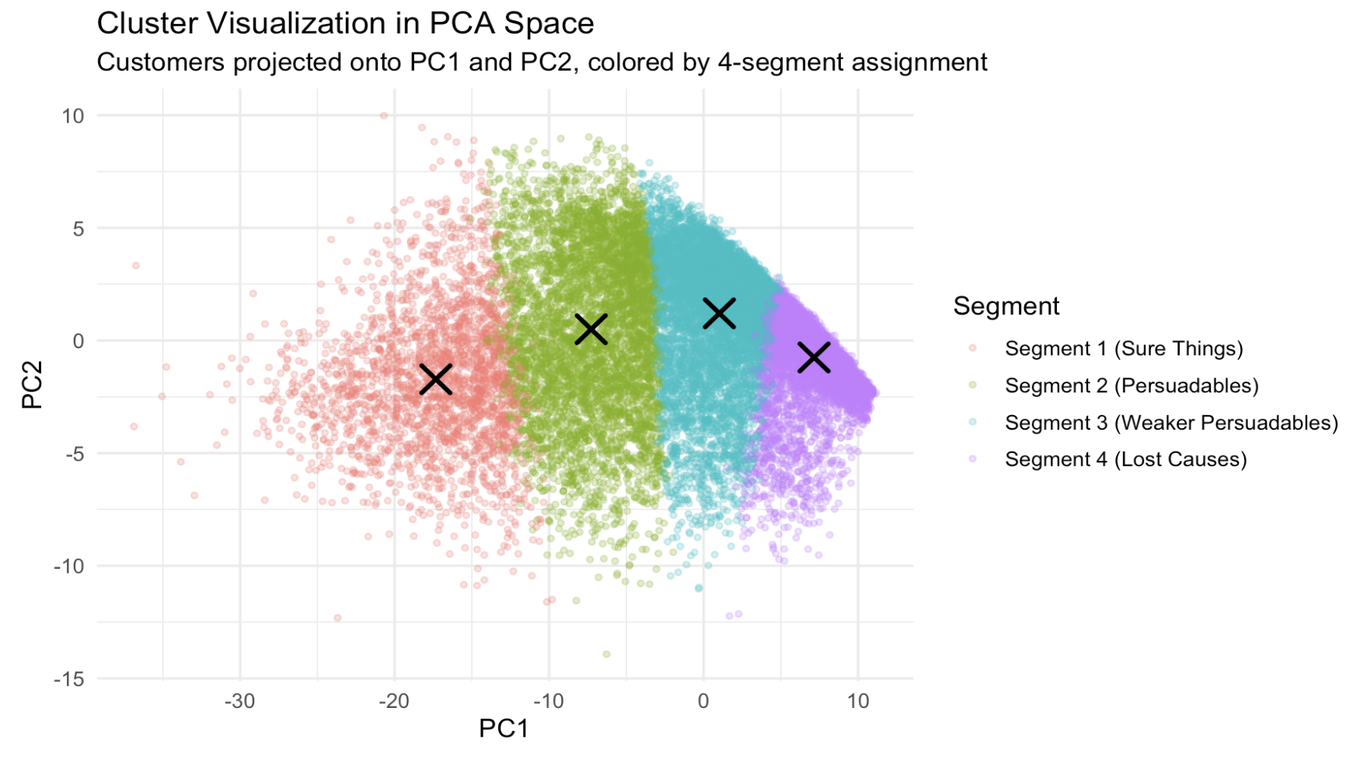
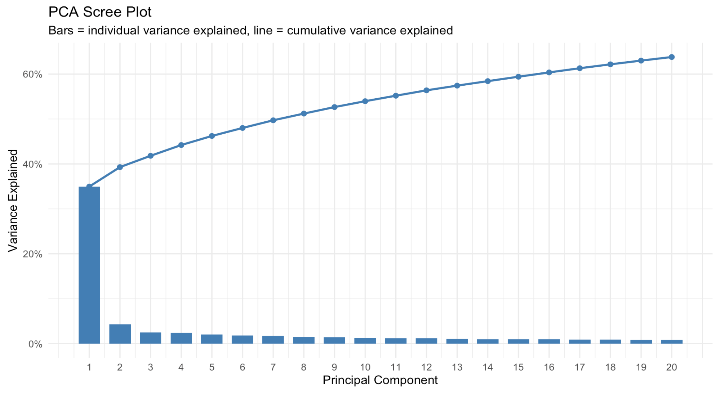
Behavior-based Segmentation
Interpretation:
PC1 captures the largest share of variance, with diminishing returns from later components.
Cluster boundaries are strongest along a gradient of behavior intensity, rather than sharp demographic splits.

Slide 8
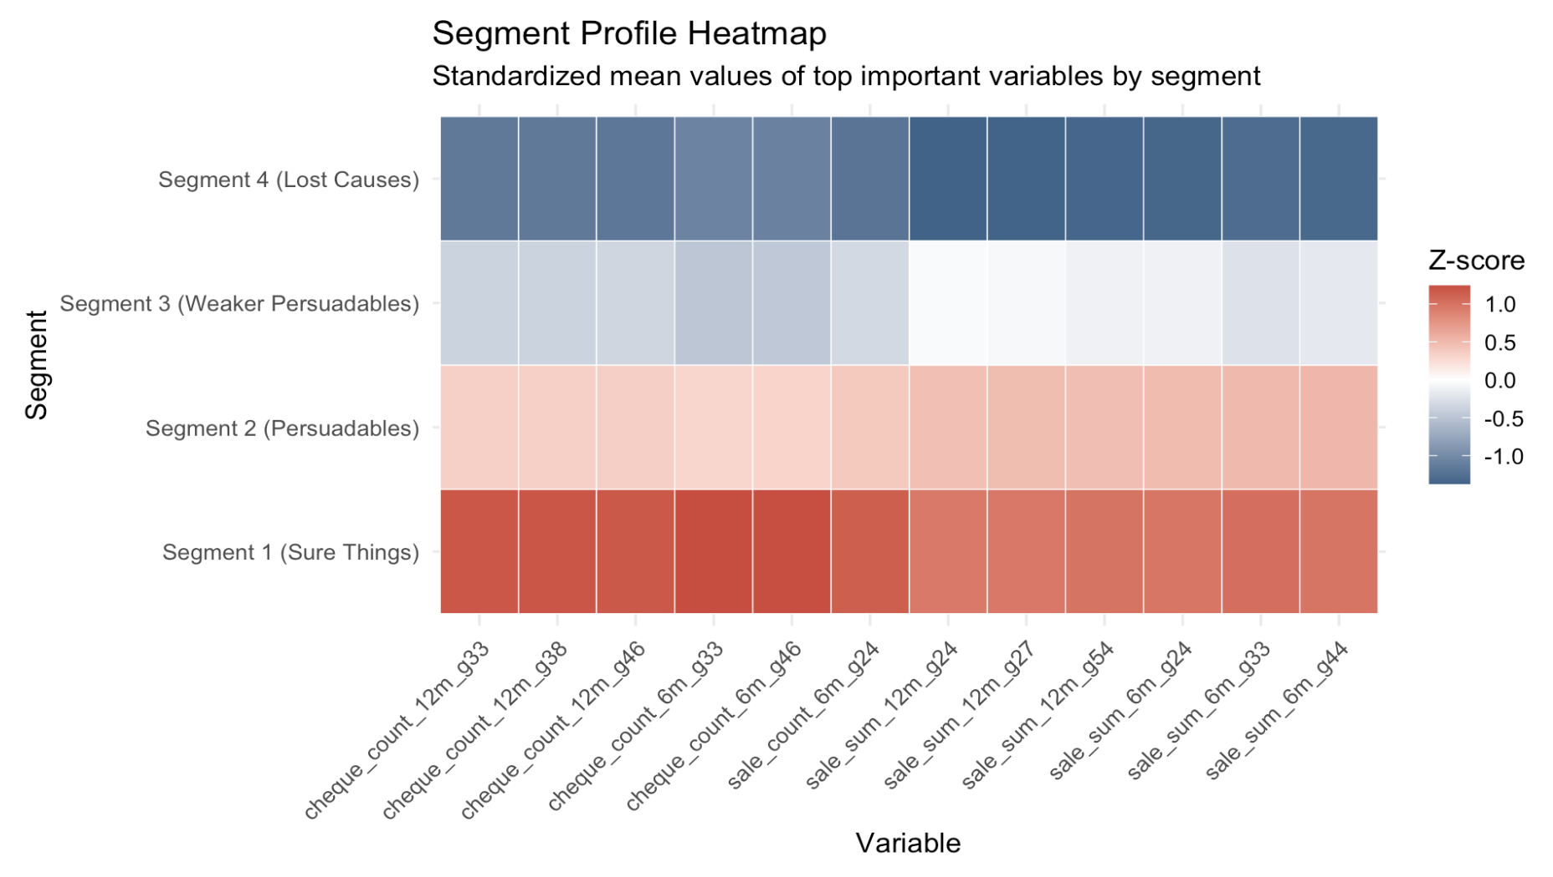
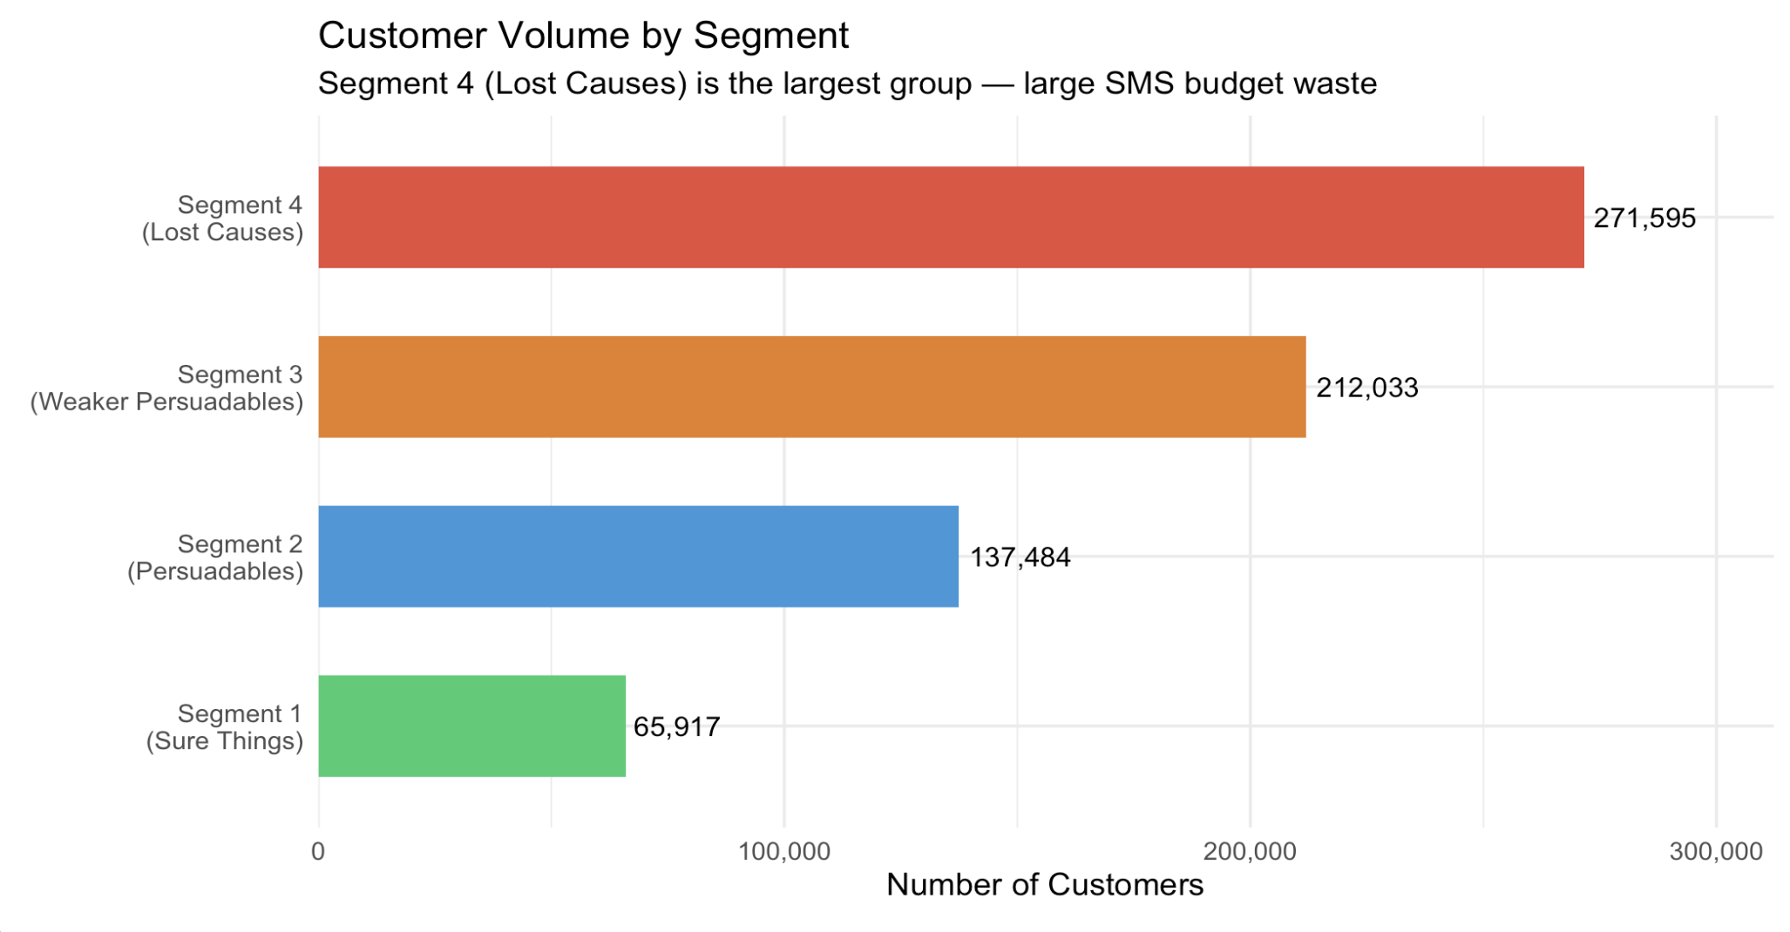
Visuals of the Four Segments:
Interpretation:
Seg. 1: Strongest Spending and receipt activity
Seg. 2: Still highly engaged, but below segment 1 baseline intensity
Seg. 3: Moderate engagement and moderate activity
Seg. 4: Largest group, but weakest overall shopping intensity

Slide 9
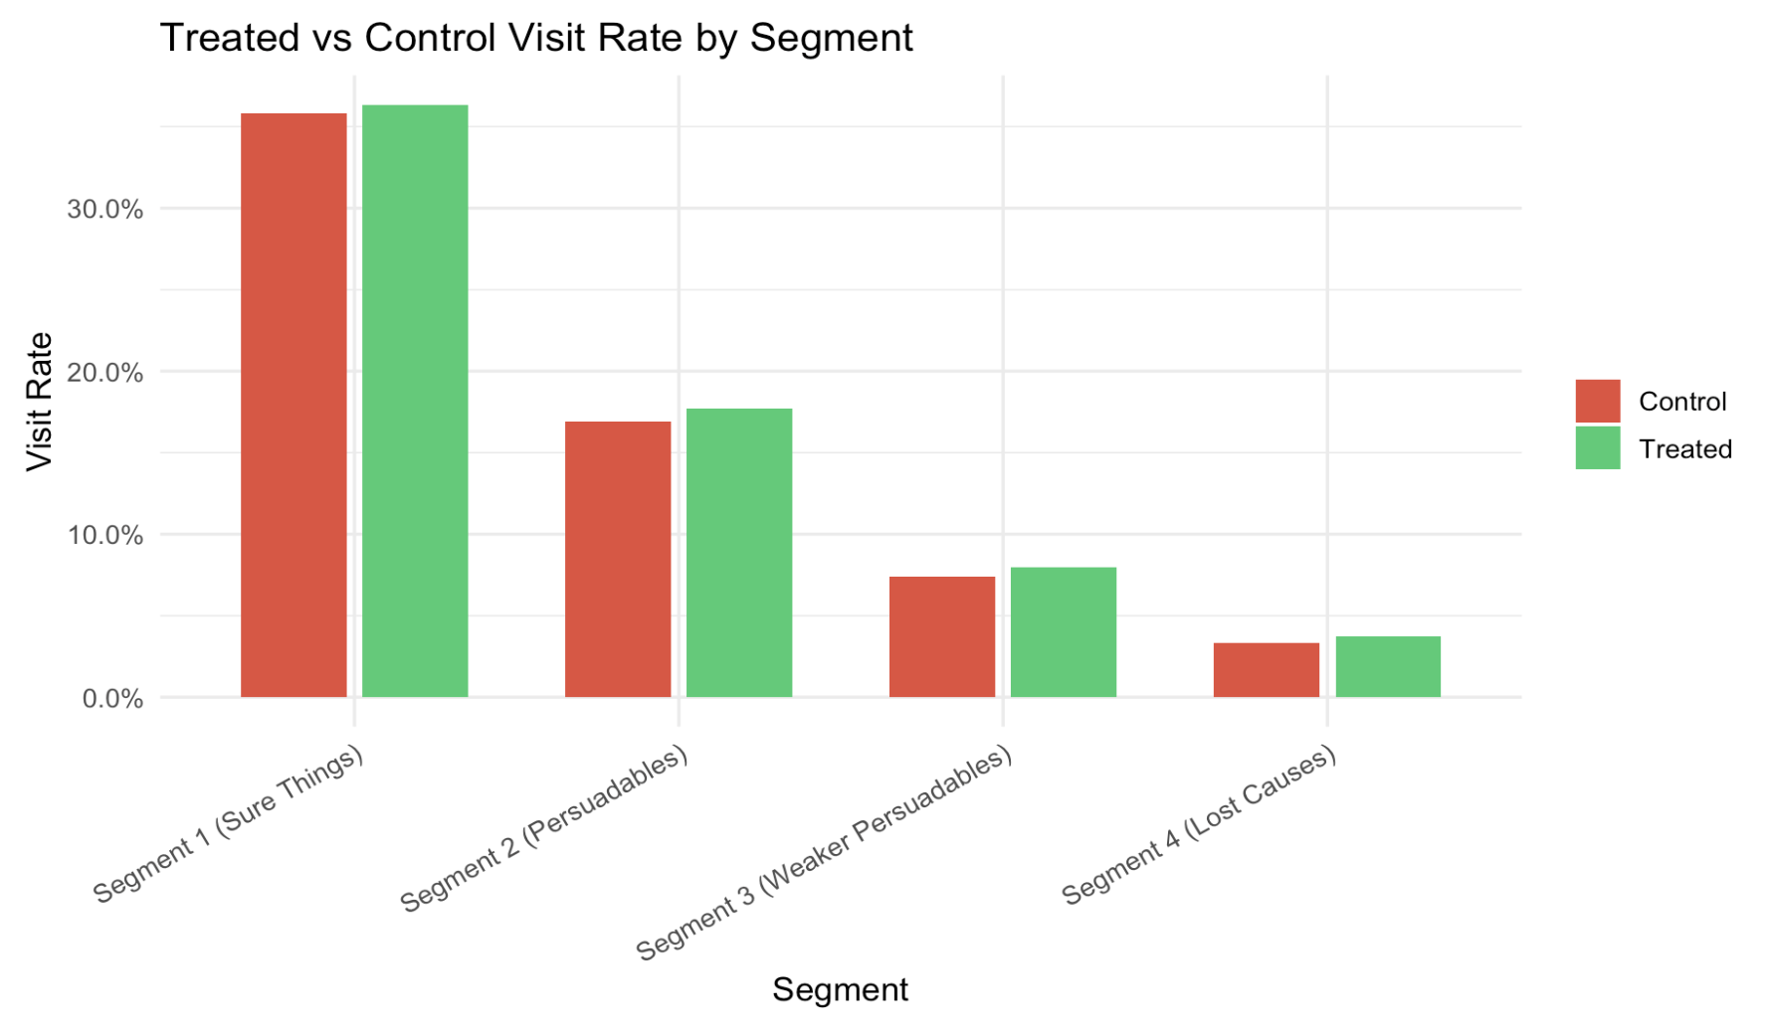
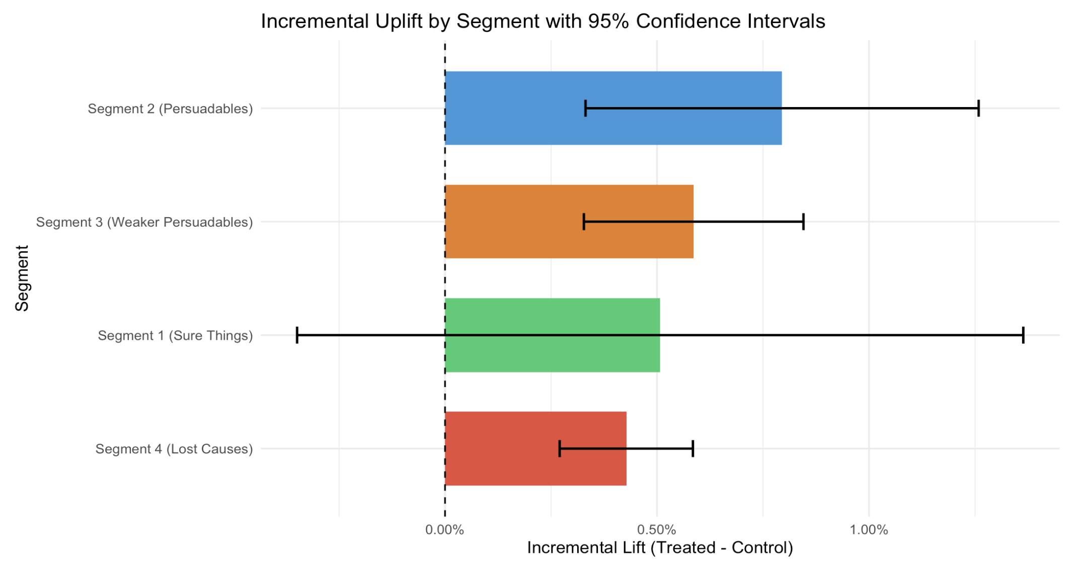
Decision Metric = Uplift
Segment 2:
Segment 3:
Segment 1:
Segment 4:
0.80 %
0.59 %
0.51%
0.43 %
Strongest Persuadable
Positive, but weaker
CI crosses Zero
Low baseline response

Slide 10
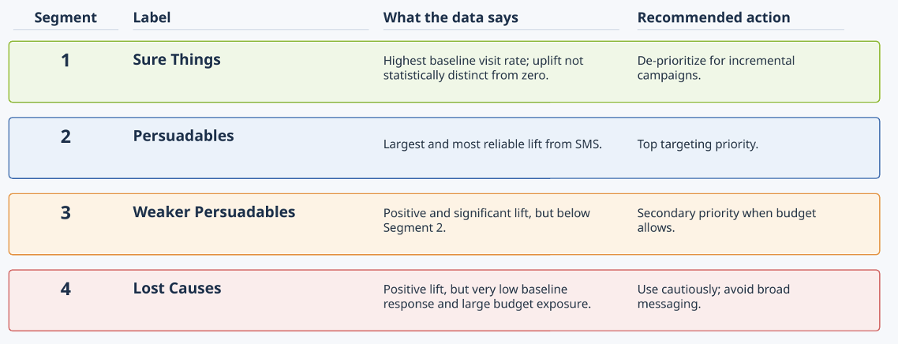
Business Interpretation of Segments
* No clear Do-Not-Disturb segment!

Slide 11
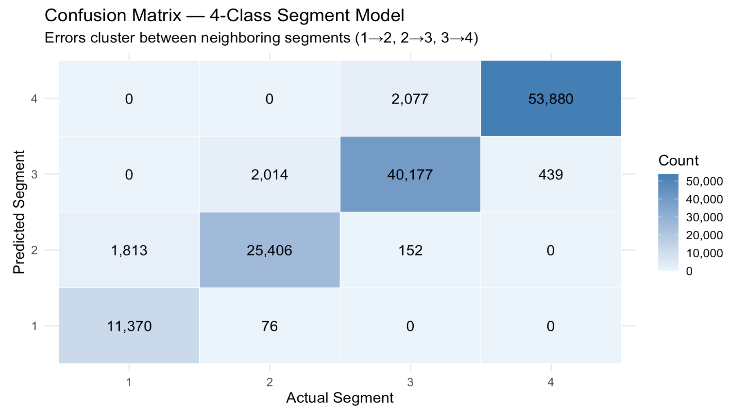
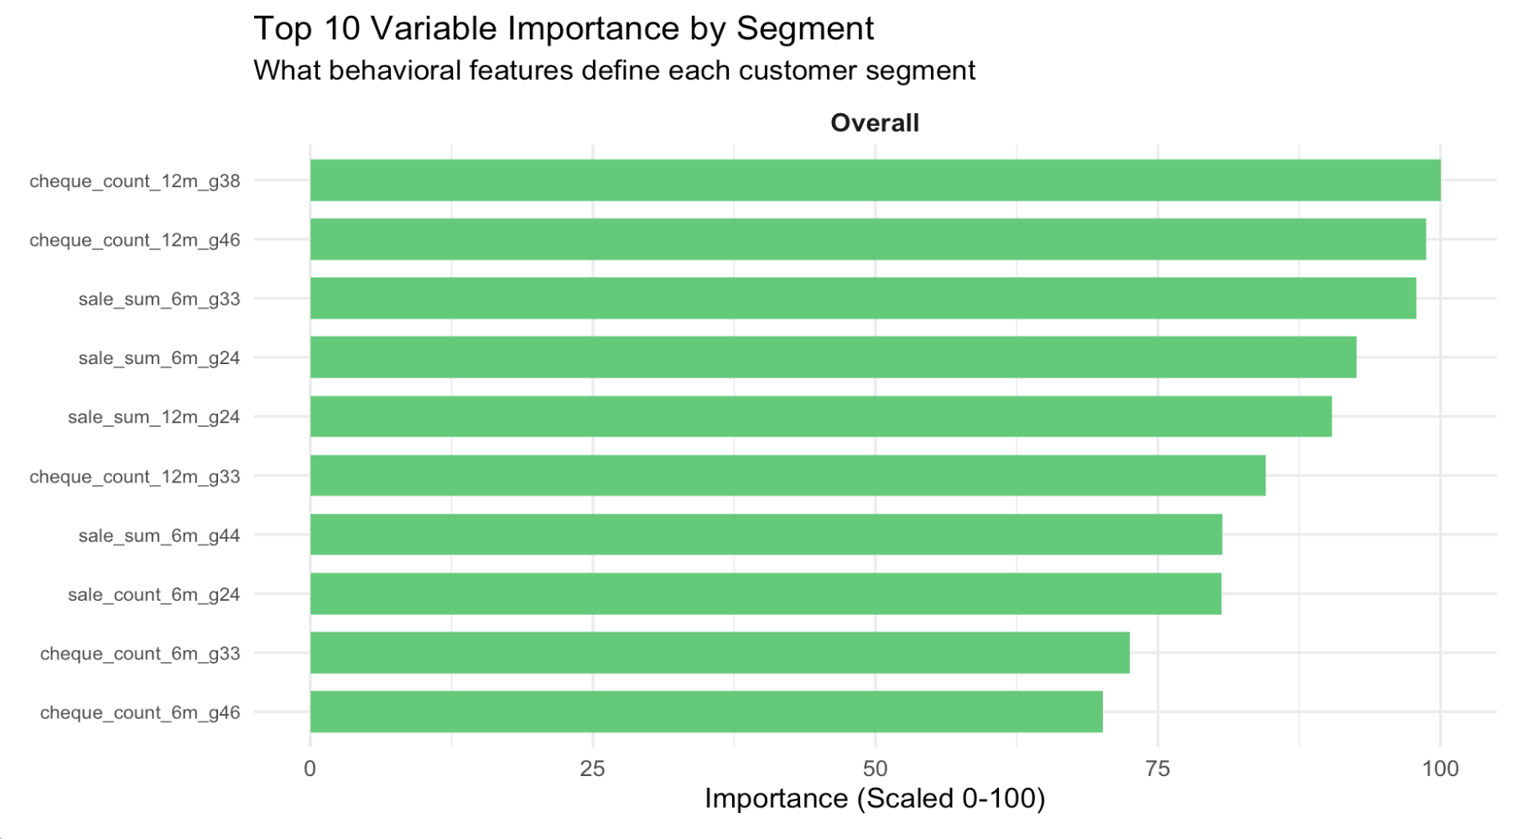
Segments are Stable & Learnable!
Accuracy:
Kappa:
Best tuning:
Boundary Pattern:
mtry = 2
extratrees
Most errors are between neighboring segments
95.22%
0.931

Slide 12
Binary Persuadables Model
Accuracy:
AUC:
Sensitivity:
Specificity:
96.82%
0.9967
0.9774
0.9587
Why combine Segments 2 and 3?
Both segments have positive, statistically supported uplift
The 4-class model often confuses the two segments
A binary label is easier for real campaign teams to deploy
What the model is learning :
Persuadability is driven more by behavior than demographics
The strongest signals are moderate to strong spending, receipt volume, and promotional interaction
[Score customers, then concentrate SMS on the highest-ranked persuadables

Slide 13
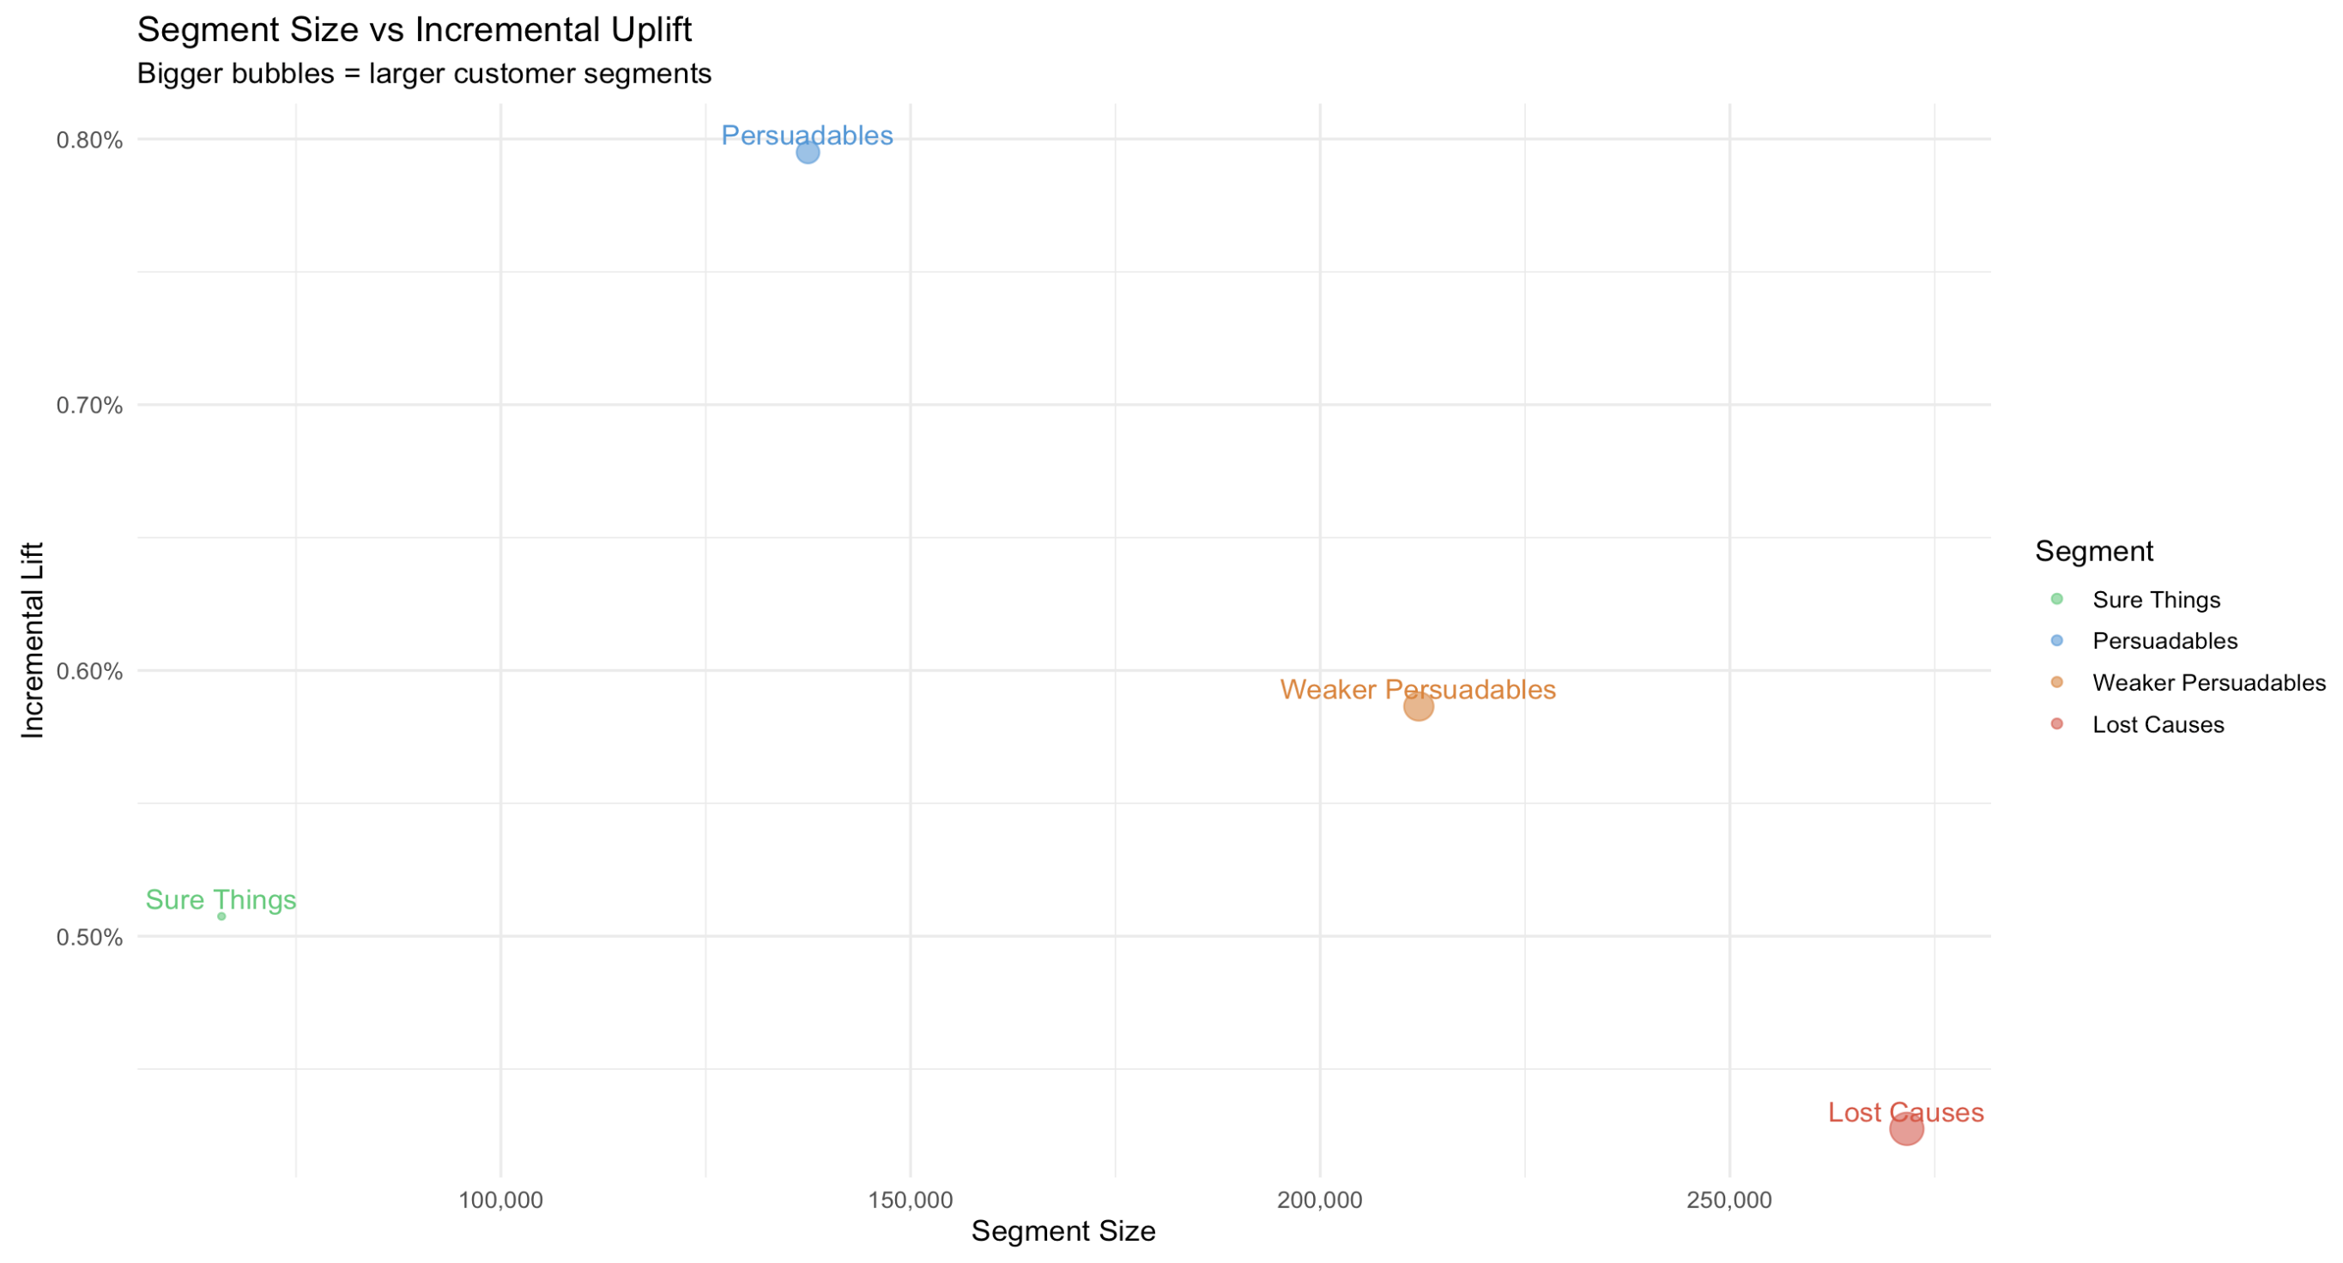
Targeting Strategy with limited SMS Budget:
Prioritize Segment 2:
Highest uplift and best incremental value per message
Expand to Segment 3:
Positive lift makes it a strong secondary audience
De-prioritize Segment 1:
High baseline activity means many would visit store anyway
Use Segment 4 Cautiously:
Large segment size can absorb budget while delivering response

Slide 14
Limitations & Next Steps:
Limitations:
Next Steps:
Treatment is estimated at the segment level, not as a full individual-level uplift score.
Segment labels are behavioral interpretations, not permanent customer identities.
No distinct Do-Not-Disturb segment
Analysis optimizes incremental visits, not full financial return.
Build an individual-level uplift model to rank expected treatment effect directly
Incorporate SMS cost, order value, and customer lifetime value to optimize profit
Refresh the segmentation over time as customer behavior evolves
Run a live test comparing targeted deployment against current campaign strategy

Slide 15
Thanks!
Questions?

